Slide 1
Measures of Central Tendency
or
Measures of Location
or
Measures of Averages
Notes:
‹#›

Slide 2
Central Tendency
Measure of Central Tendency:
A single summary score that best describes the central location of an entire distribution of scores.
The typical score.
The center of the distribution.
One distribution can have multiple locations where scores cluster.
Must decide which measure is best for a given situation.
Notes:
‹#›

Slide 3
Central Tendency
Measures of Central Tendency:
Mean
The sum of all scores divided by the number of scores.
Median
The value that divides the distribution in half when observations are ordered.
Mode
The most frequent score.
Notes:
‹#›

Slide 4
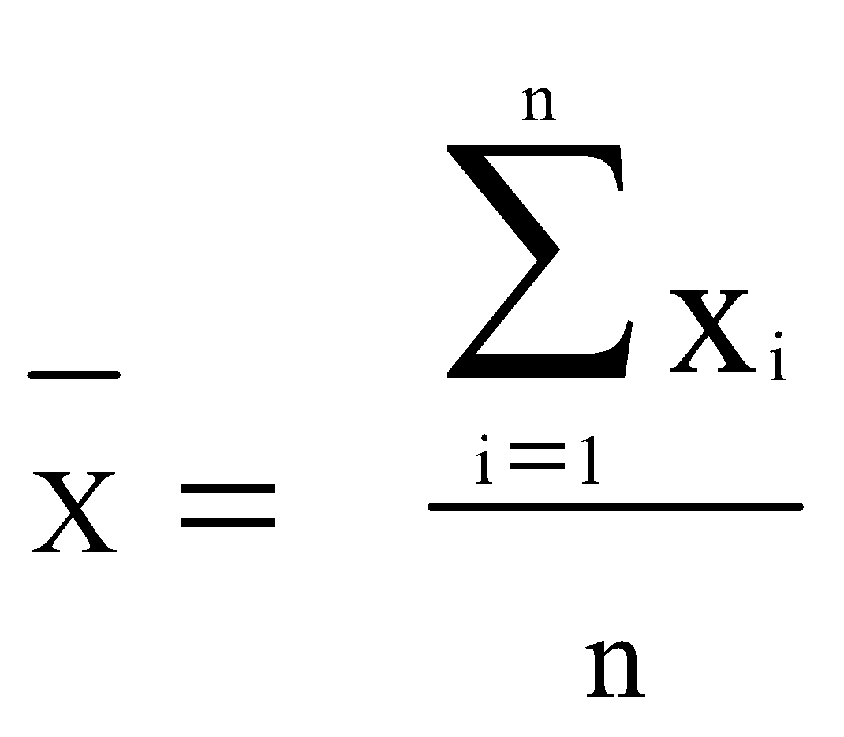
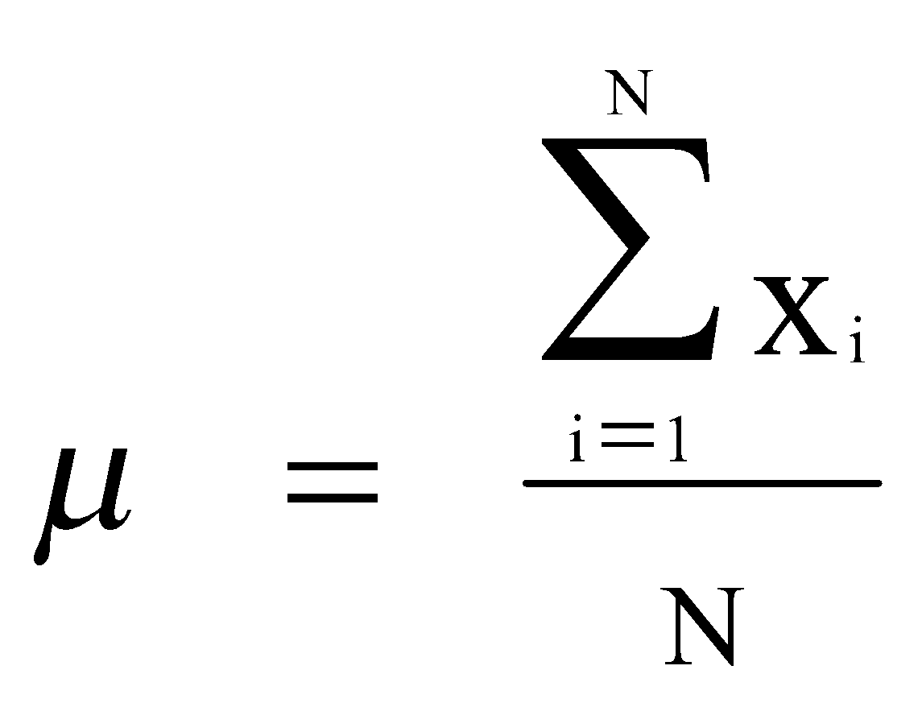
Measure of central tendency
Arithmetic Mean (Mean)
Definition:
Sum of all the observation s divided by the number of the observations
The arithmetic mean is the most common measure of the central location of a sample.
Population
Sample
Notes:
‹#›

Slide 5
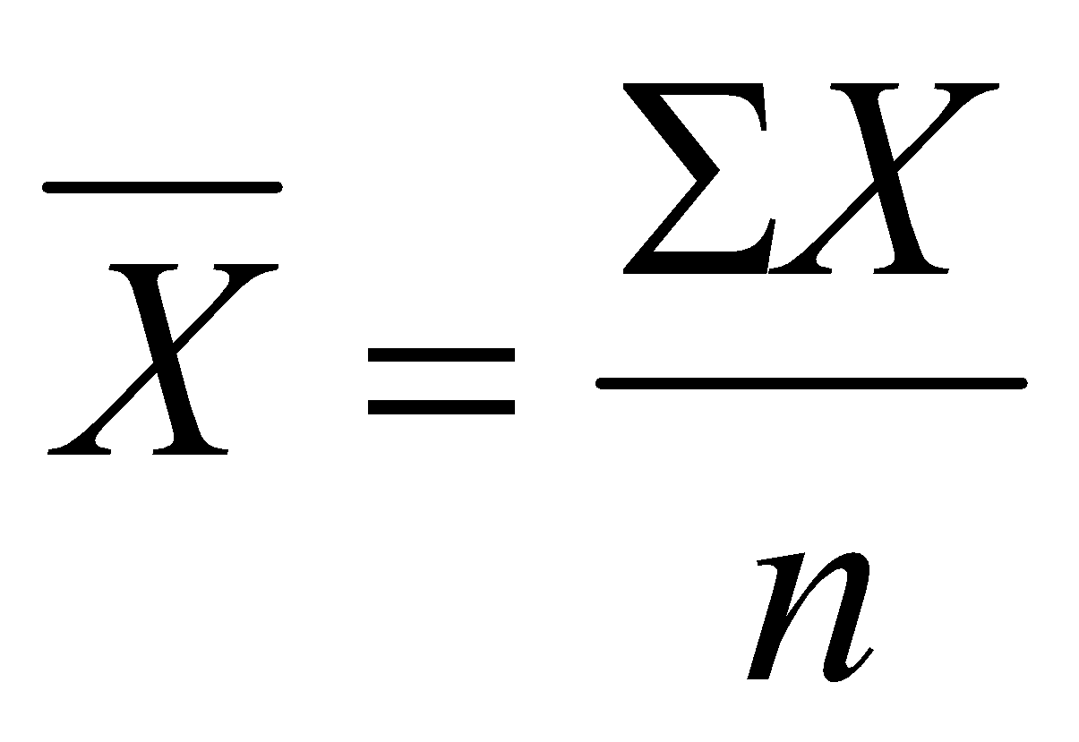
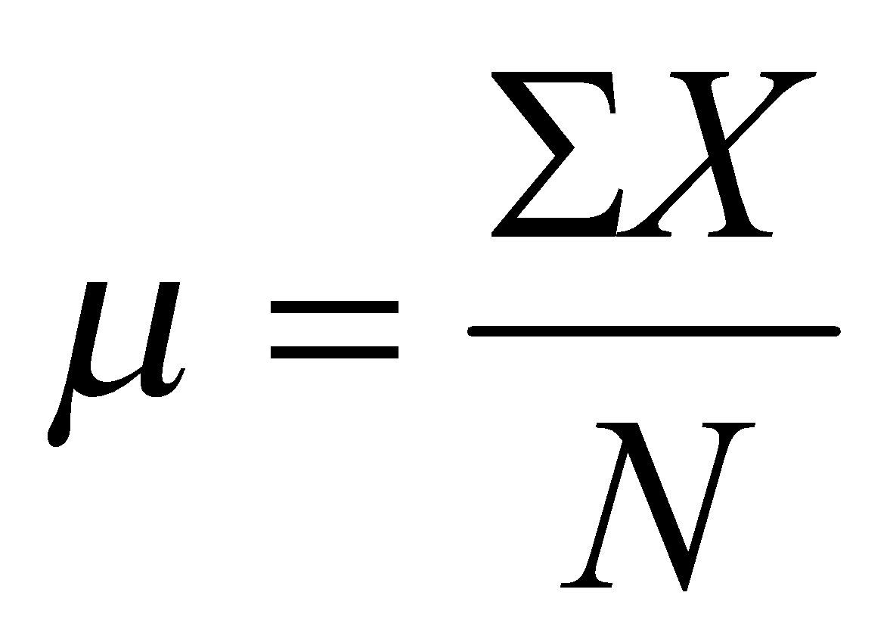
Mean
“sigma”, the sum of X, add up all scores
Population
Sample
“mu”
“N”, the total number of scores in a population
“sigma”, the sum of X, add up all scores
“X bar”
“n”, the total number of scores in a sample
Notes:
‹#›

Slide 6
Mean: Example
Data: {1,3,6,7,2,3,5}
number of observations: 7
Sum of observations: 27
Mean: 3.9
Notes:
‹#›

Slide 7
Simple Frequency Distributions
raw-score distribution
frequency distribution
name | X
Student1 | 20
Student2 | 23
Student3 | 15
Student4 | 21
Student5 | 15
Student6 | 21
Student7 | 15
Student8 | 20
f | X
3 | 15
2 | 20
2 | 21
1 | 23
χ
Σf
χ =
Mean
N
Notes:
‹#›

Slide 8
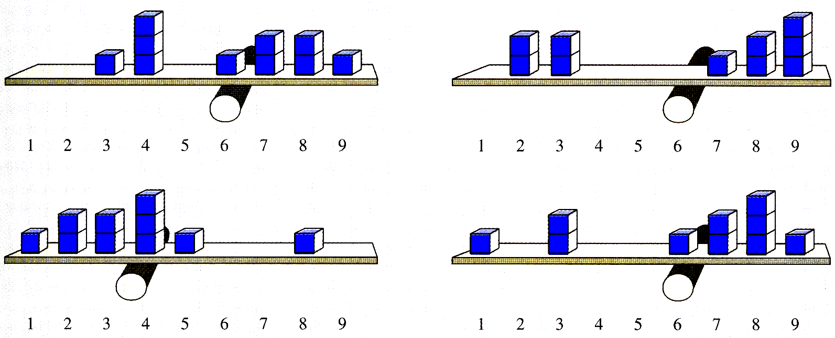
Mean
Is the balance point of a distribution.
The sum of negative deviations from the mean exactly equals the sum of positive deviations from the mean.
Notes:
‹#›

Slide 9
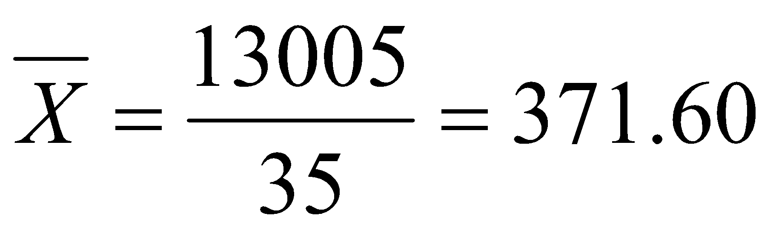
Central Tendency Example: Mean
52, 76, 100, 136, 186, 196, 205, 150, 257, 264, 264, 280, 282, 283, 303, 313, 317, 317, 325, 373, 384, 384, 400, 402, 417, 422, 472, 480, 643, 693, 732, 749, 750, 791, 891
Mean hotel rate:
Mean hotel rate: $371.60
Notes:
‹#›

Slide 10
Pros and Cons of the Mean
Pros
Mathematical center of a distribution.
Good for interval and ratio data.
Does not ignore any information.
Inferential statistics is based on mathematical properties of the mean.
Cons
Influenced by extreme scores and skewed distributions.
May not exist in the data.
Notes:
‹#›

Slide 11
Some Important Properties of the Mean
Interval-Ratio Level of Measurement
Center of Gravity(the mean balances all the scores).
Sensitivity to Extremes
Notes:
‹#›

Slide 12

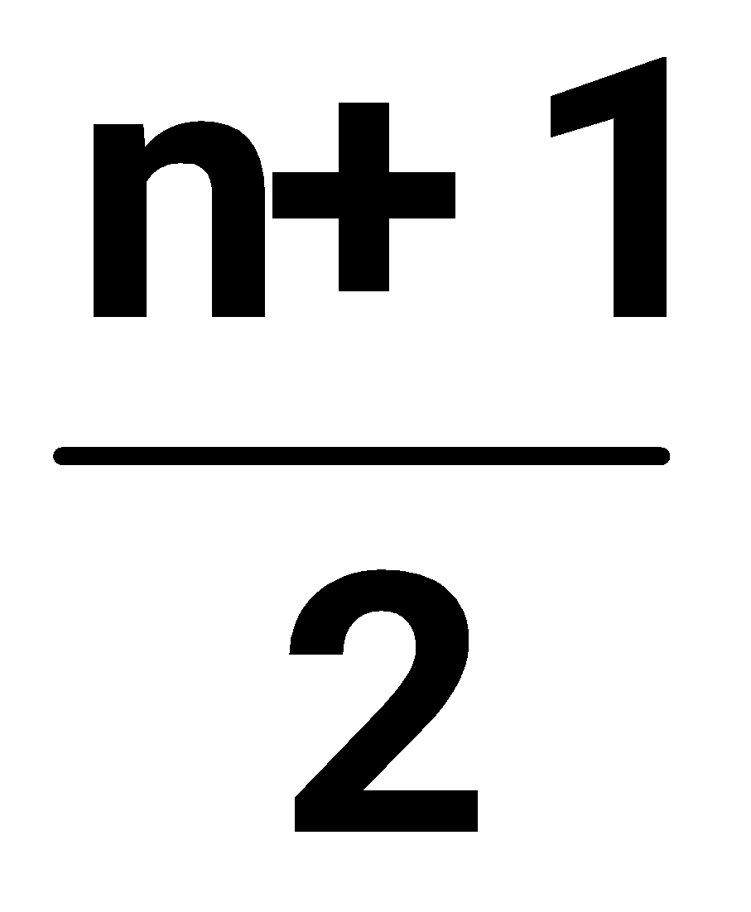

Median
Definition:
The value that is larger than half the population and smaller than half the population
n is odd: the median score
5, 8, 9, 10, 28 median = 9
n is even: the th score
6, 17, 19, 20, 21, 27 median = 19.5
Notes:
‹#›

Slide 13
Pros and Cons of Median
Pros
Not influenced by extreme scores or skewed distributions.
Good with ordinal data.
Easier to compute than the mean.
Cons
May not exist in the data.
Doesn’t take actual values into account.
Notes:
‹#›

Slide 14
Mode Most frequently occurring value
Data {1,3,7,3,2,3,6,7}
Mode : 3
Data {1,3,7,3,2,3,6,7,1,1}
Mode : 1,3
Data {1,3,7,0,2,-3, 6,5,-1}
Mode : none
Notes:
‹#›

Slide 15
Central Tendency Example: Mode
52, 76, 100, 136, 186, 196, 205, 150, 257, 264, 264, 280, 282, 283, 303, 313, 317, 317, 325, 373, 384, 384, 400, 402, 417, 422, 472, 480, 643, 693, 732, 749, 750, 791, 891
Mode: most frequent observation
Mode(s) for hotel rates:
264, 317, 384
Notes:
‹#›

Slide 16
Pros and Cons of the Mode
Pros
Good for nominal data.
Easiest to compute and understand.
The score comes from the data set.
Cons
Ignores most of the information in a distribution.
Small samples may not have a mode.
Notes:
‹#›

Slide 17
Example: Central Location
Suppose the age in years of the first 10 subjects enrolled in your study are:
34, 24, 56, 52, 21, 44, 64, 34, 42, 46
Then the mean age of this group is 41.7 years
To find the median, first order the data:
21, 24, 34, 34, 42, 44, 46, 52, 56, 64
The median is 42 +44 = 43 years
2
The mode is 34 years.
Notes:
‹#›

Slide 18
Comparison of Mean and Median
Mean is sensitive to a few very large (or small) values “outliers” so sometime mean does not reflect the quantity desired.
Median is “resistant” to outliers
Mean is attractive mathematically
50% of sample is above the median, 50% of sample is below the median.
Notes:
‹#›

Slide 19
Suppose the next patient enrolls and their age is 97 years.
How does the mean and median change?
To get the median, order the data:
21, 24, 34, 34, 42, 44, 46, 52, 56, 64, 97
If the age were recorded incorrectly as 977 instead of 97, what would the new median be? What would the new mean be?
Notes:
‹#›

Slide 20
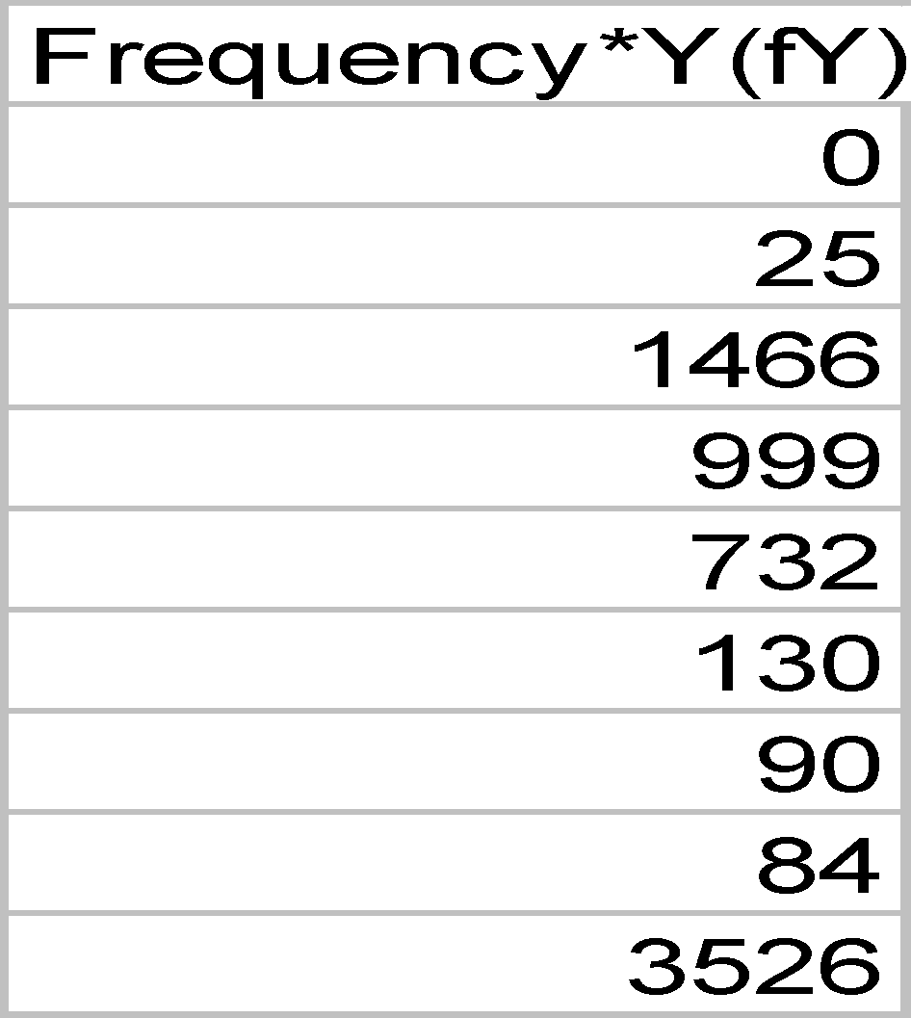
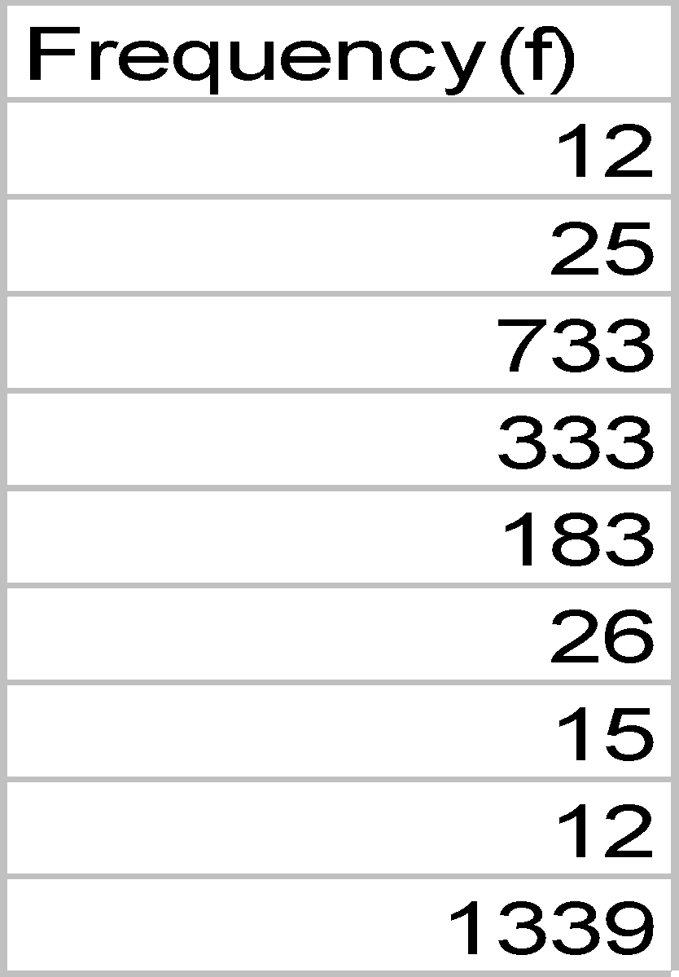
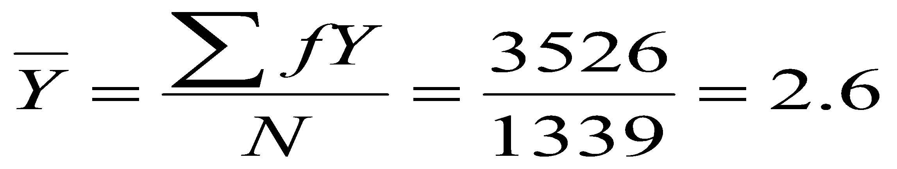
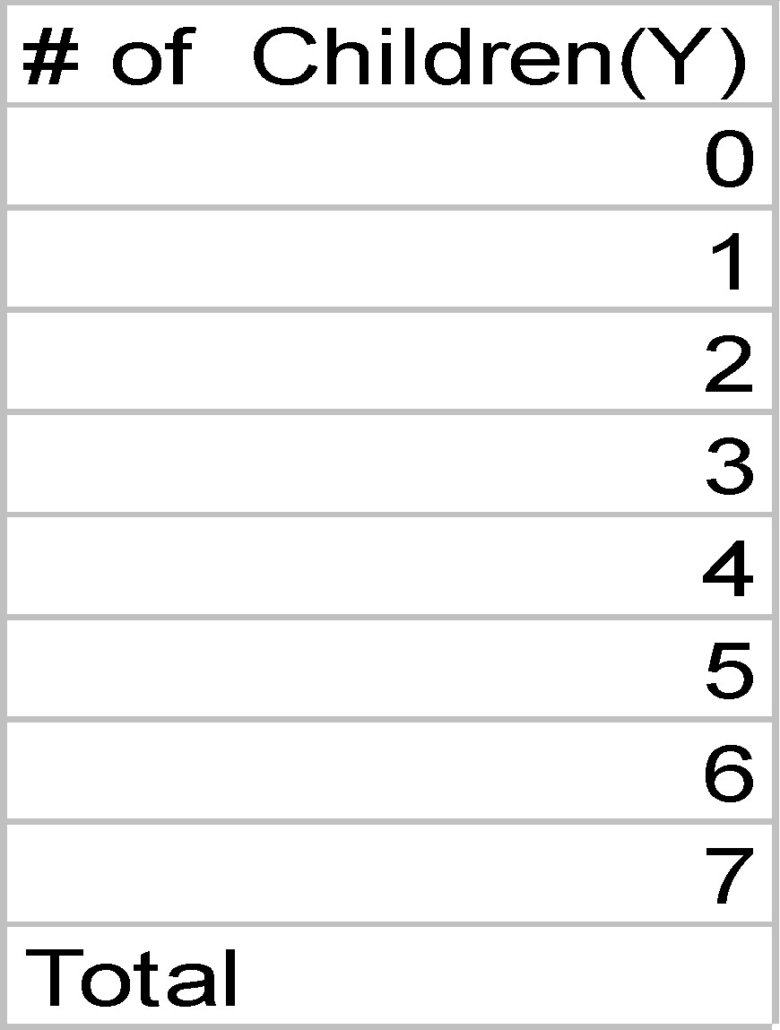
Calculating the Mean from a Frequency Distribution
Notes:
‹#›

Slide 21
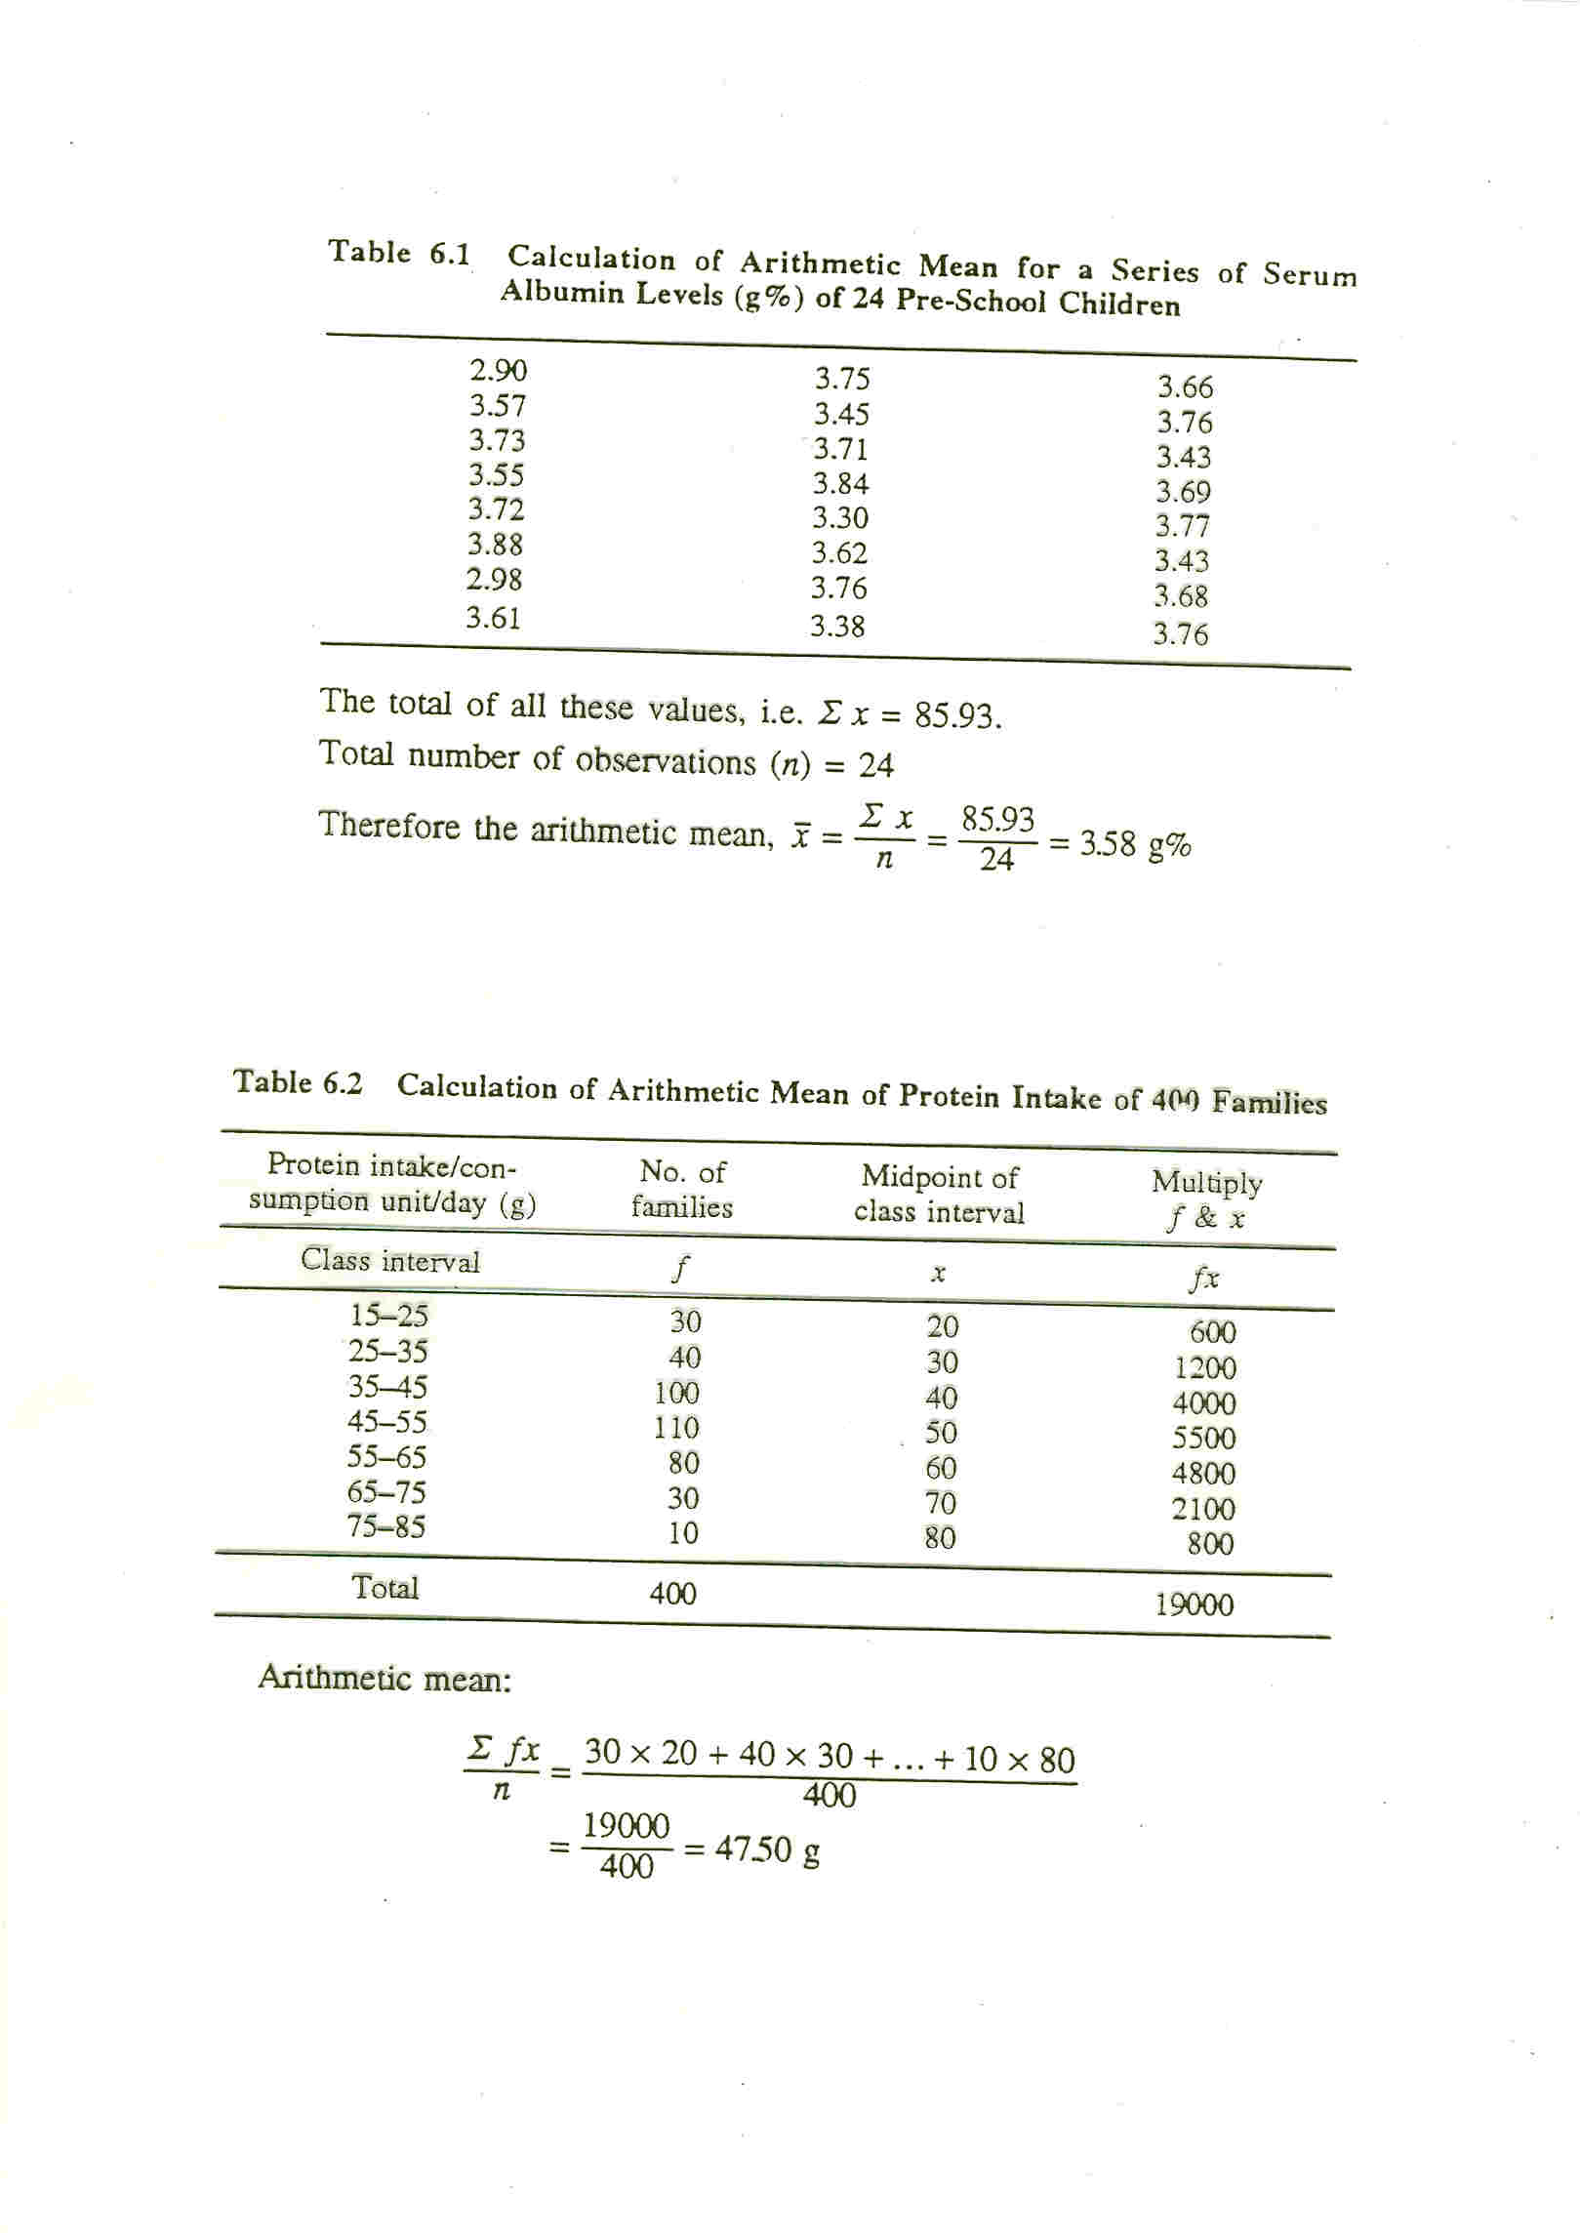
Notes:
‹#›

Slide 22
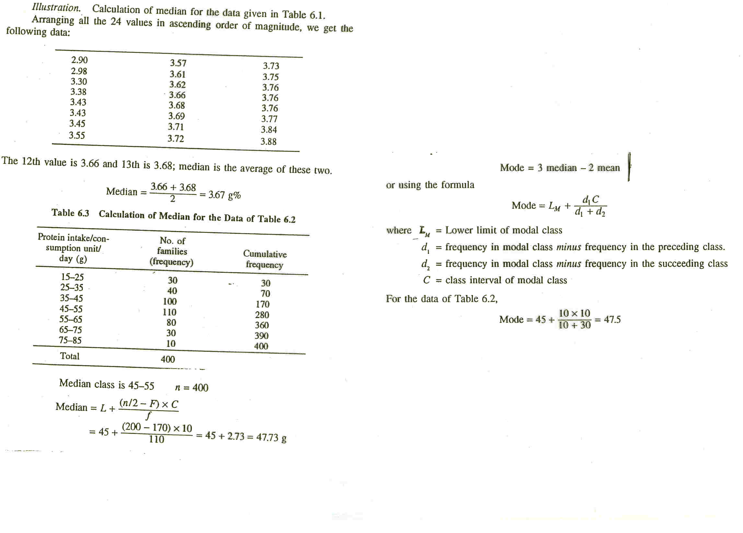
Notes:
‹#›

Slide 23
MEASURES OF Central Tendency
Geometric Mean
& Harmonic Mean
Notes:
‹#›

Slide 24
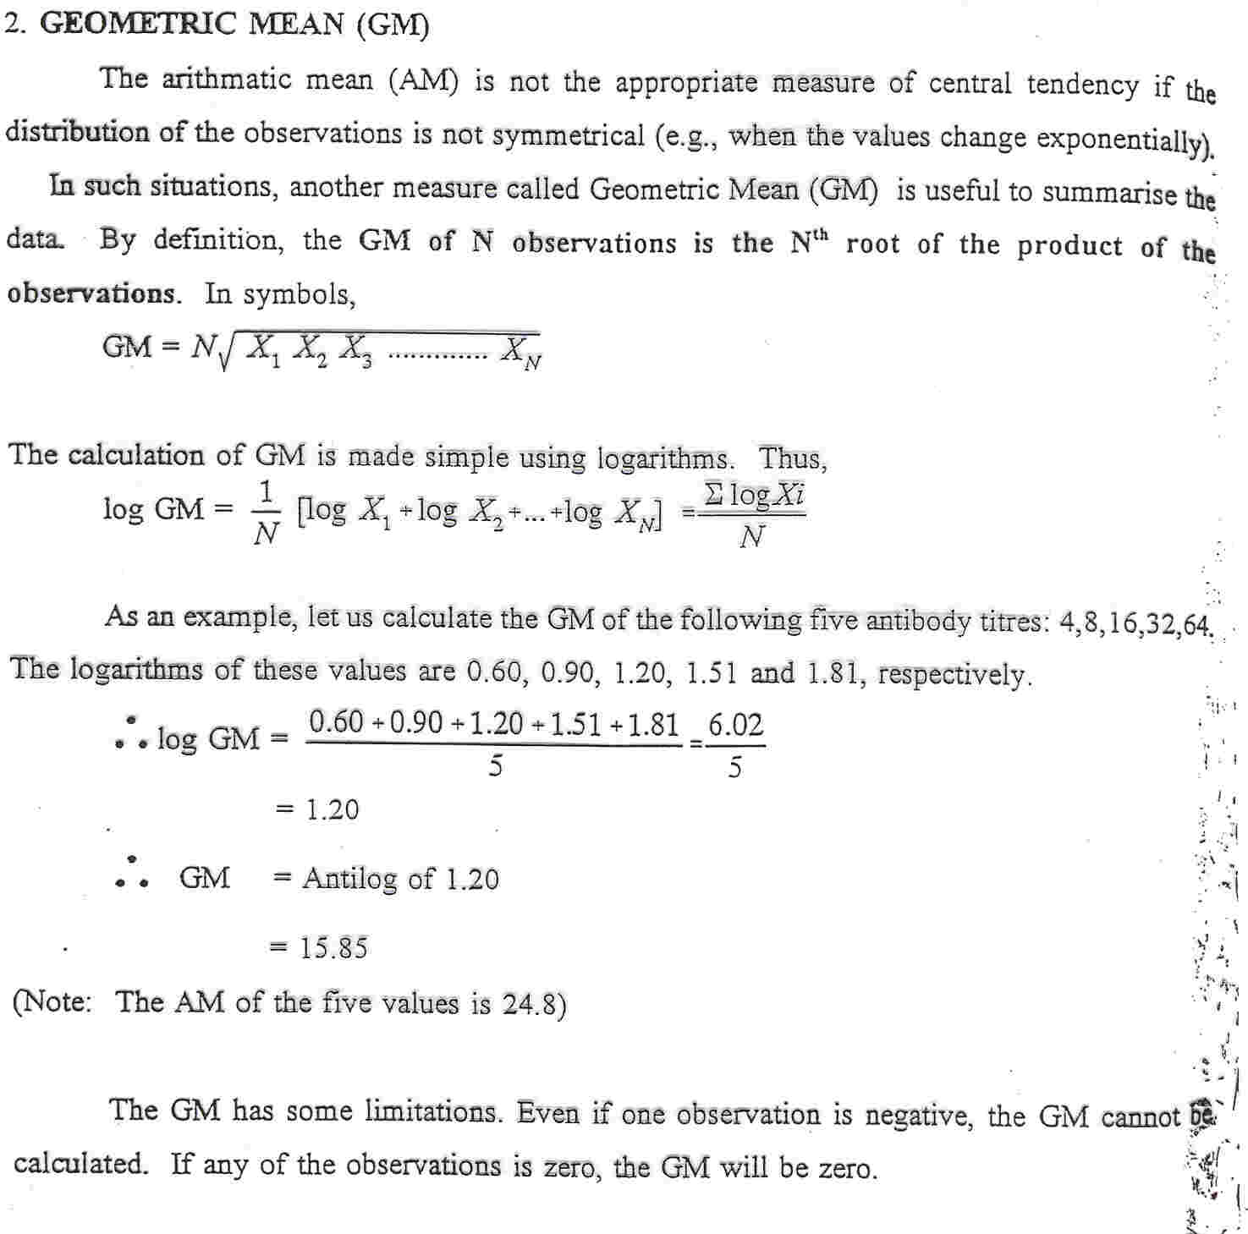
Notes:
‹#›

Slide 25
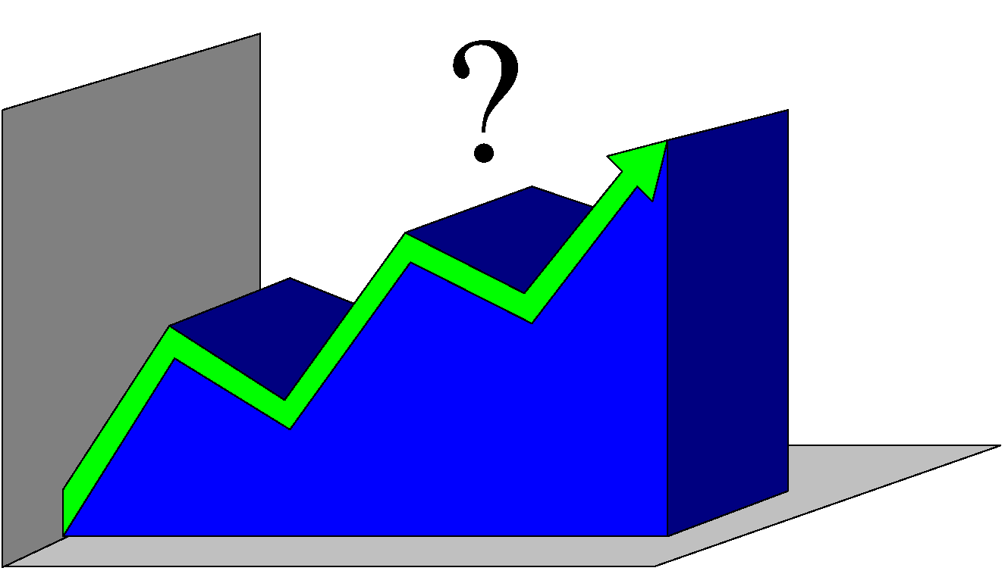
The Shape of Distributions
Distributions can be either symmetrical or skewed, depending on whether there are more frequencies at one end of the distribution than the other.
Notes:
‹#›

Slide 26
Symmetrical Distributions
A distribution is symmetrical if the frequencies at the right and left tails of the distribution are identical, so that if it is divided into two halves, each will be the mirror image of the other.
In a symmetrical distribution the mean, median, and mode are identical.
Notes:
‹#›

Slide 27
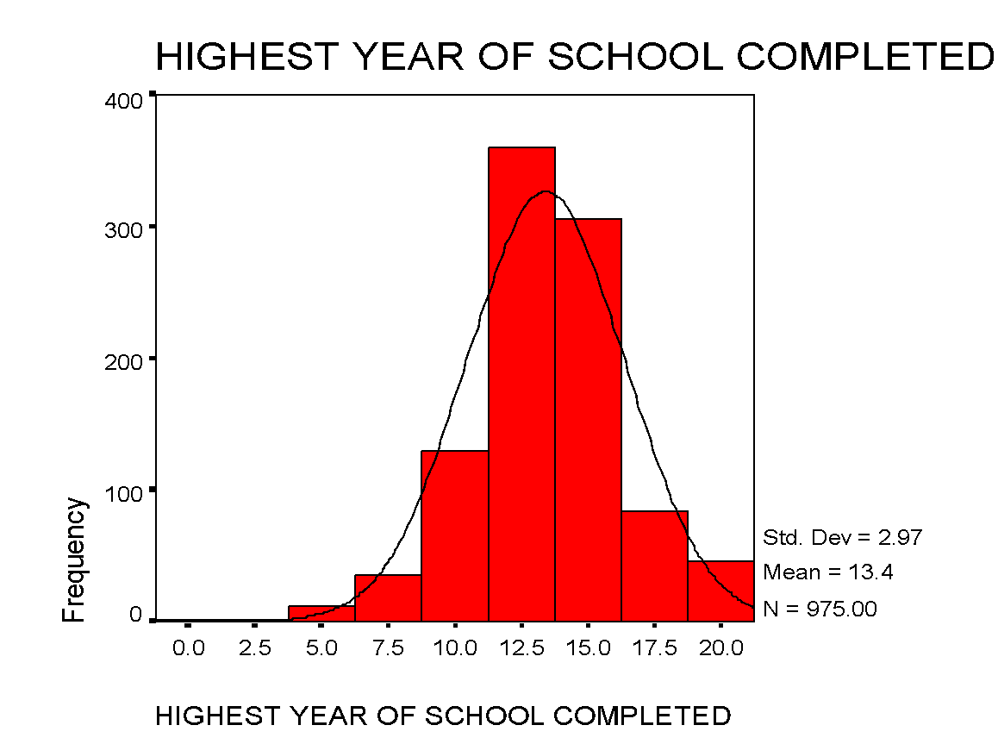
Almost Symmetrical distribution
Mean=13.4
Mode=13.0
Notes:
‹#›

Slide 28
Skewed Distribution: Skewed Distributin Few extreme values on one side of the distribution or on the other.
Positively skewed distributions: distributions which have few extremely high values (Mean>Median)
Negatively skewed distributions: distributions which have few extremely low values(Mean<Median)
Notes:
‹#›

Slide 29
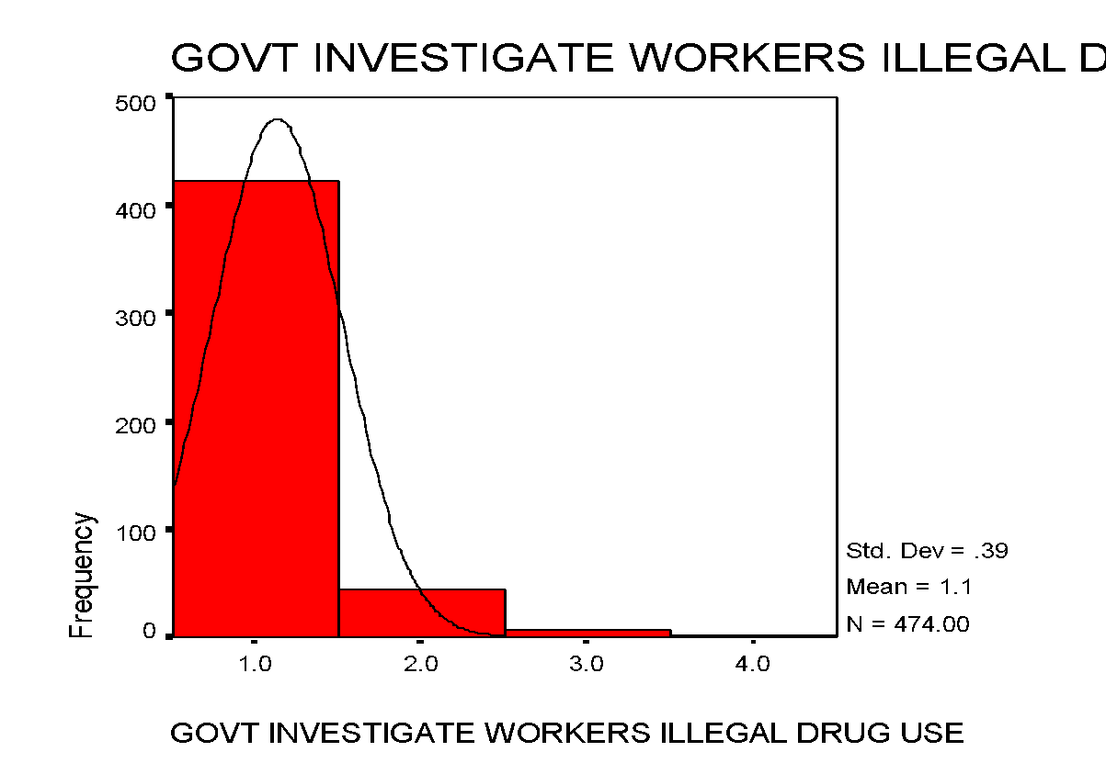
Positively Skewed Distribution
Mean=1.13
Median=1.0
Notes:
‹#›

Slide 30
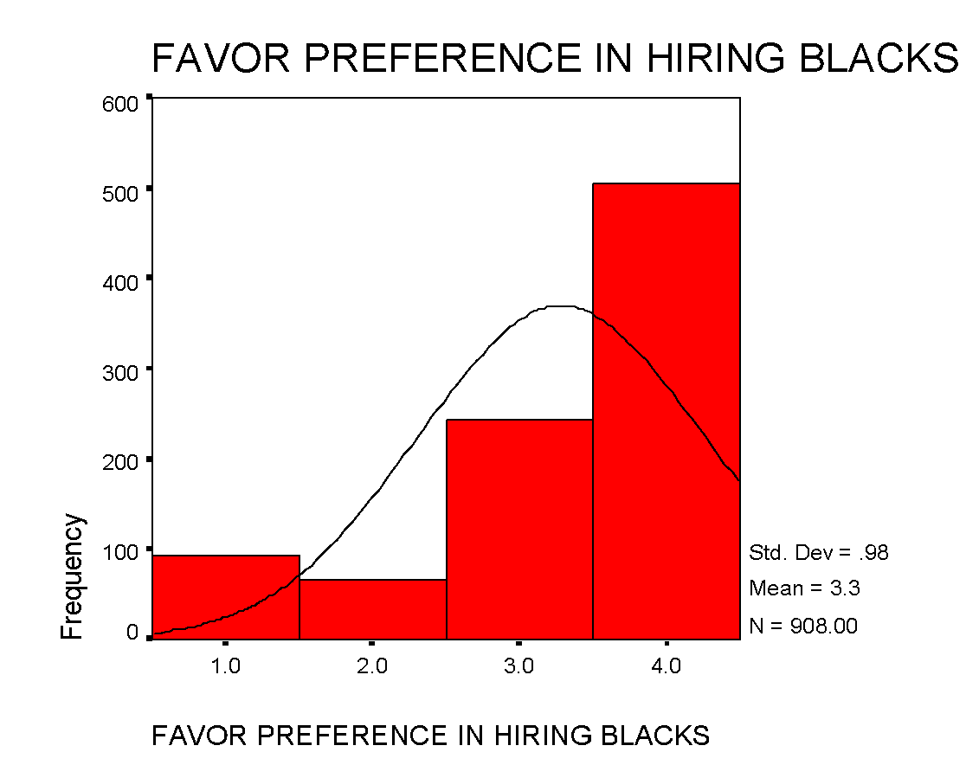
Negatively Skewed distribution
Mean=3.3
Median=4.0
Notes:
‹#›

Slide 31
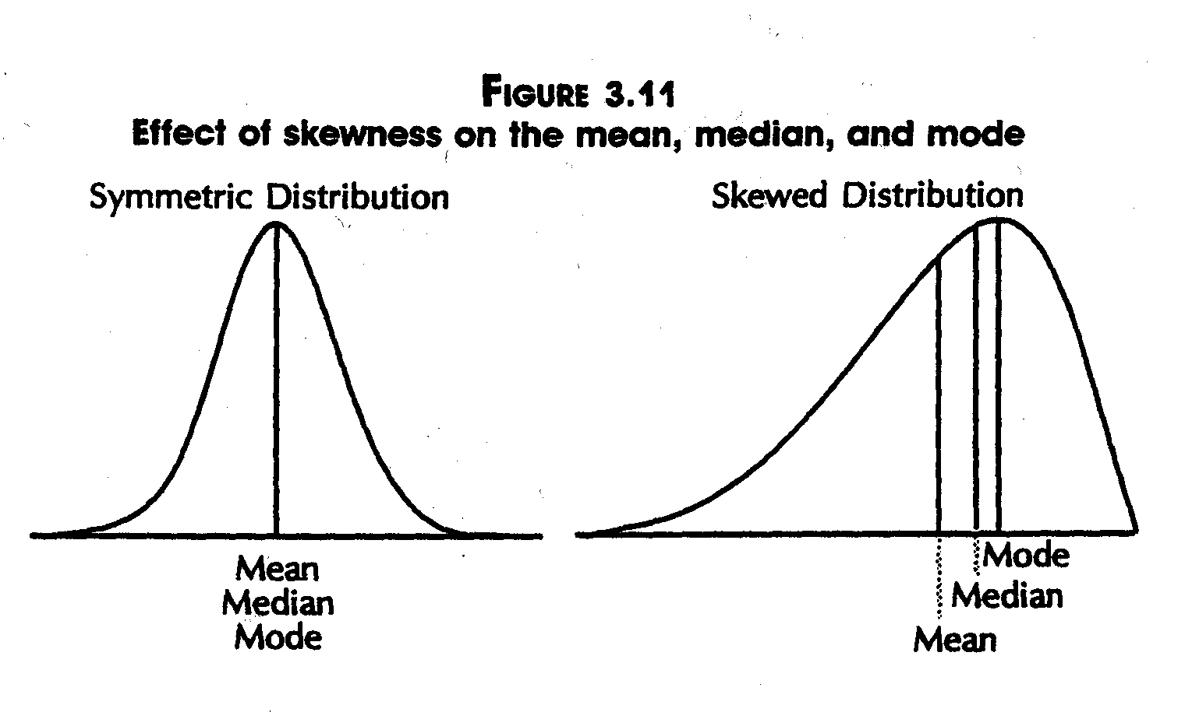
Mean, Median and Mode
Notes:
‹#›

Slide 32
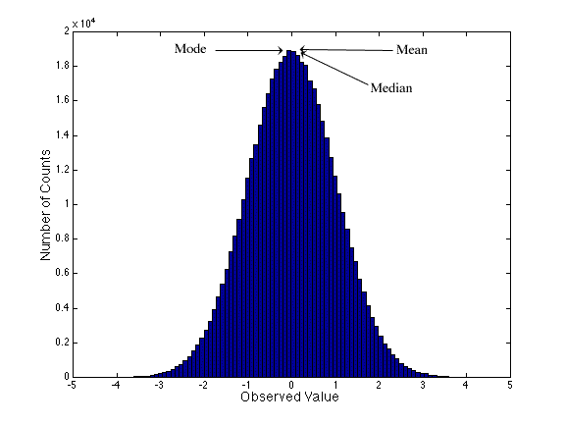
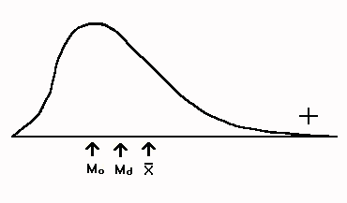
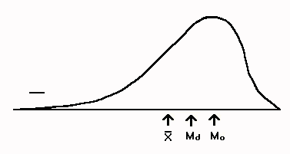
Distributions
Bell-Shaped (also known as symmetric” or “normal”)
Skewed:
positively (skewed to the right) – it tails off toward larger values
negatively (skewed to the left) – it tails off toward smaller values
Notes:
‹#›

Slide 33
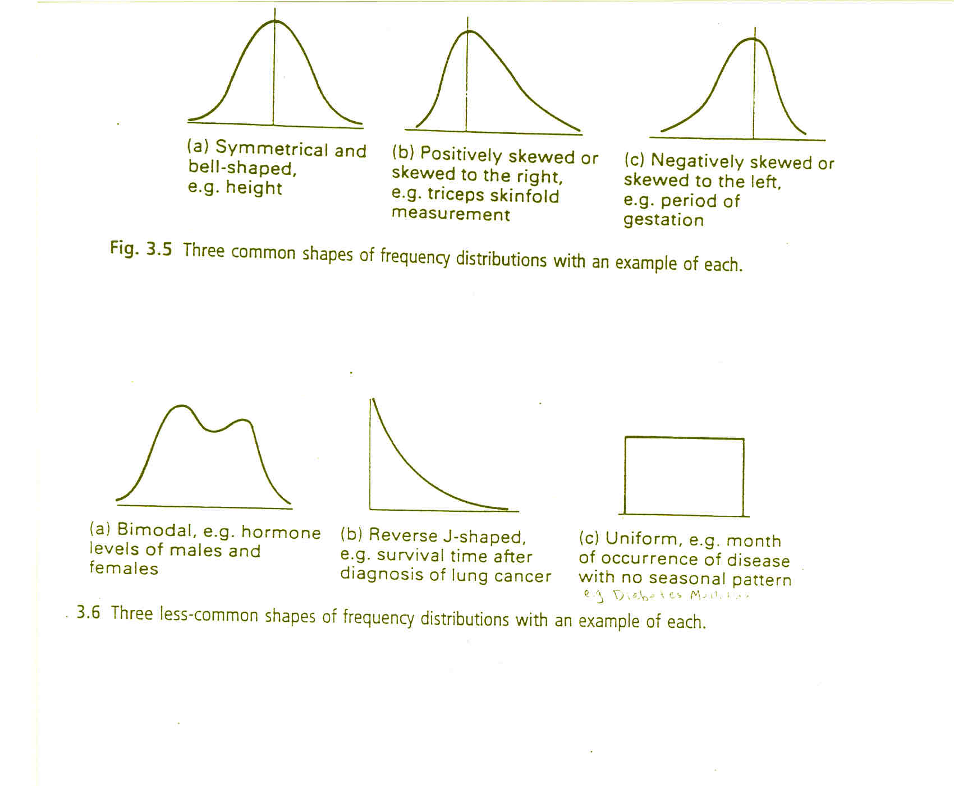
Notes:
‹#›

Slide 34
Choosing a Measure of Central Tendency
IF variable is Nominal..
Mode
IF variable is Ordinal...
Mode or Median(or both)
IF variable is Interval-Ratio and distribution is Symmetrical…
Mode, Median or Mean
IF variable is Interval-Ratio and distribution is Skewed…
Mode or Median
Notes:
‹#›

Slide 35


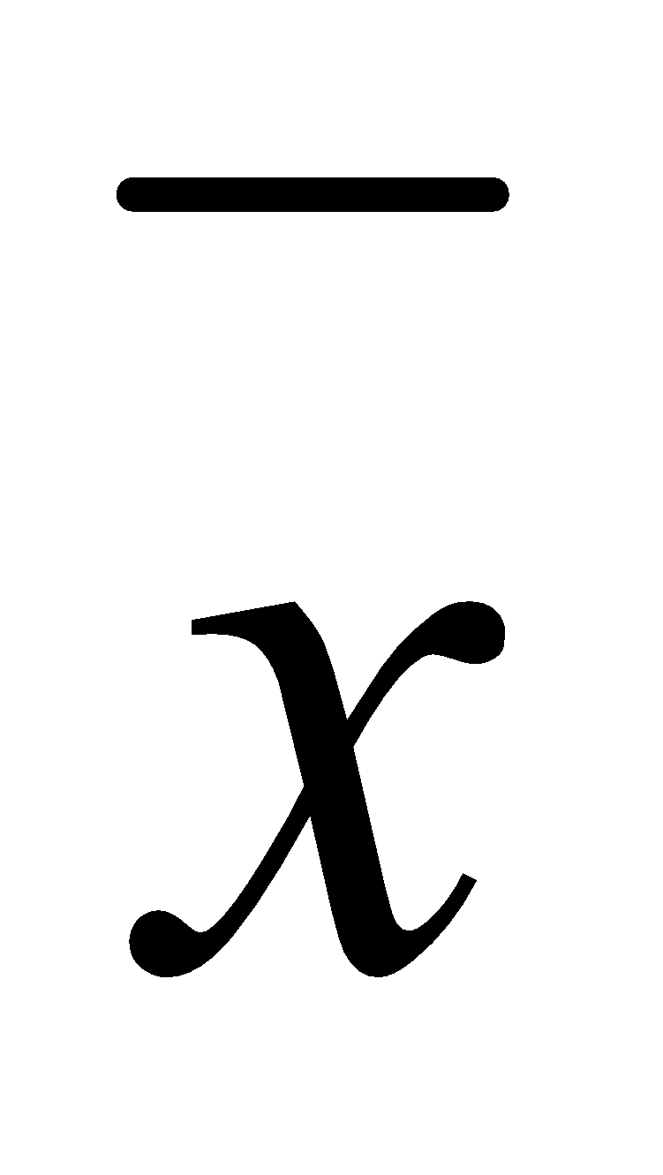

EXAMPLE:
(1) 7,8,9,10,11 n=5, x=45, =45/5=9
(2) 3,4,9,12,15 n=5, x=45, =45/5=9
(3) 1,5,9,13,17 n=5, x=45, =45/5=9
S.D. : (1) 1.58 (2) 4.74 (3) 6.32
Notes:
‹#›

